Slide 1

The Job Search Helper
Project 3
Team 3

Slide 2

FINDING A JOB IS CONFUSING.
EVERY EMPLOYER USES DIFFERENT TERMS AND WORDS IN JOB LISTINGS.
WOULDN’T IT BE EASIER TO BE ABLE TO SEE WHAT ALL THE EMPLOYERS ARE ASKING FOR IN A EMPLOYMENT FIELD?
AND IN WHAT REGIONS THEYRE HIRING?
WE HAVE CREATED AN APP TO SHOW THE USER AND OVERVIEW OF THE VARIOUS LOCATIONS, THE COMPANIES AND A VISUAL SUMMARY OF WHAT TERMS/BUZZWORDS THEY USE IN THE LISTING
Notes:
JOB SEARCH HELPER
FINDING A JOB IS CONFUSING. EVERY EMPLOYER USES DIFFERENT TERMS AND WORDS IN JOB LISTINGS TO SHOW THEIR DESIRED APPLICANT.
AS AN APPLICANT, WOULDN’T IT BE EASIER TO BE ABLE TO SEE WHAT ALL THE EMPLOYERS ARE ASKING FOR IN A EMPLOYMENT FIELD?
AND IN WHAT REGIONS THEYRE HIRING?
WE HAVE CREATED AN APP TO SHOW THE USER AND OVERVIEW OF THE VARIOUS LOCATIONS, THE COMPANIES AND A VISUAL SUMMARY OF WHAT TERMS/BUZZWORDS THEY USE IN THE LISTING

Slide 3
Our Approach and Method
1 – Webscrape | 2 - ETL | 3 – Flask app | 4 - endpoints
SEEK.COM.AU - CONSTRUCTION, ENGINEERING, SALES, COMMUNITY AND HEALTH FIELDS | POSTGRESQL CREATED ERD FOR TABLES CREATED SCHEMA | FLASK APP WITH MULTIPLE ROUTES | WEBPAGE USER ENDPOINT
5 PAGES OF JOBS ~400 – 500 LISTINGS PER SCRAPE | DATA FILTERED AND EXPLODED INTO INDIVIDUAL TABLES. DATA TO PLOT HAS BEEN ANALYSED AND ADDED TO SEPARATE TABLES | JSON ROUTE FOR API USE. PLOTTING WITH PLOTLY FOR ENDPOINT | INTERACTIVE WITH NAVIGATION, SHOWING THE PLOTS
USING : PYTHON PANDAS JUPYTER NOTEBOOK BEAUTIFUL SOUP | USING: POSTGRESQL PANDAS LUCIDCHART (ERD) | USING: FLASK POSTGRESQL PLOTLY | USING: FLASK HTML/CSS FOUNDATION JS/CSS
Notes:
IDENTIFIED DATA SOURCE - SEEK
WE THEN CREATED A PYTHON WEBSCRAPING APP USING PANDAS AND BEAUTIFUL SOUP TO SCRAPE JOB LISTINGS FROM 5 PAGES, ACROSS 5 EMPLOYMENT FIELDS
THIS RESULTED IN ~400-500 RECORDS PER SCRAPE
RESULTS LOADED TO PANDAS DATAFRAME, THEN FILTERED AND SLICED ACCORING TO JOB FIELD.
JOB DESCRIPTION WERE THEN EXPLODED, TALLIED AND SUMMARIZED. WE THEN EXCLUDED ANY WORDS WITH 4 OR LESS CHARACTERS TO REMOVE NON PERTINENT ENTRIES.
FINALLY A LINK TABLE WAS CREATED FOR PLOTTING, AND TO BE USED IN ANY FUTURE DATA ANALYSIS
DATABASE DESIGNED AND ERD CREATED
DATABASE SCHEMA CREATED
CONNECTED SCRAPE APP TO POSTGRES AND SUCCESSFULLY APPENDED DATA
FLASK APP WRITTEN TO QUERY POSTGRESQL FOR DATA ROUTES
DATA PREPARED INTO DATAFRAMES OR LISTS FOR PLOTTING

Slide 4
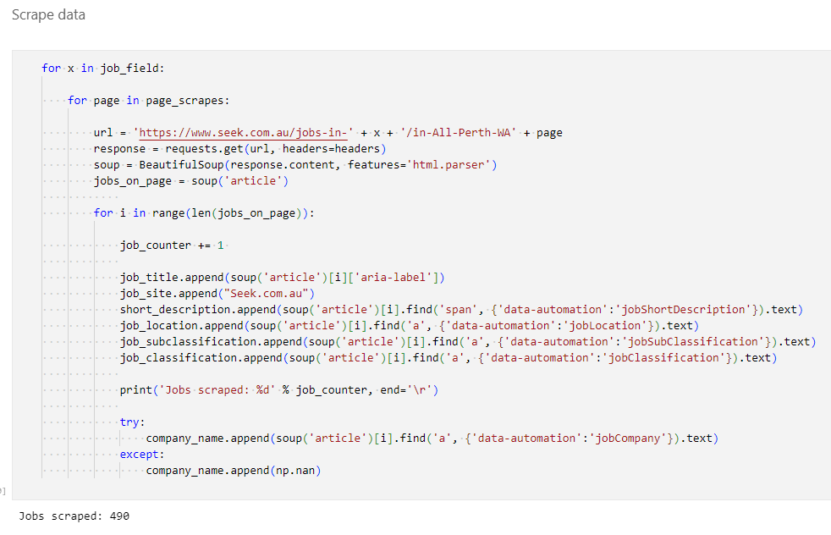
Seek Webscraping
Jobs Scraped from seek using BEAUTIFUL SOUP
Webscraping blocker avoided by adding header to request.

Slide 5
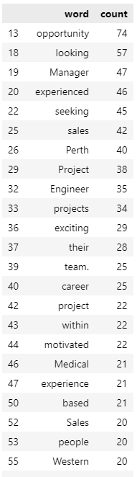
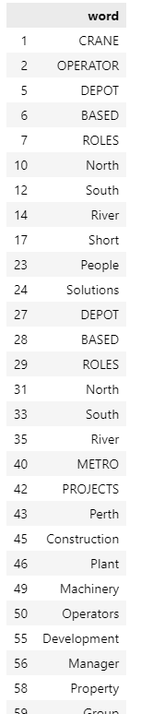
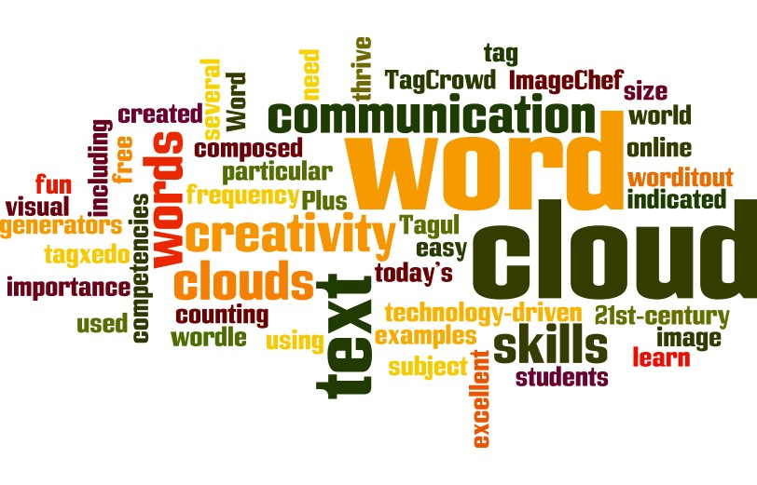
Data Transformation - Buzzwords
WORDCLOUD PLOT EXAMPLE
Words tallied and table created for both buzzword list and count
This was repeated for each job field

Slide 6
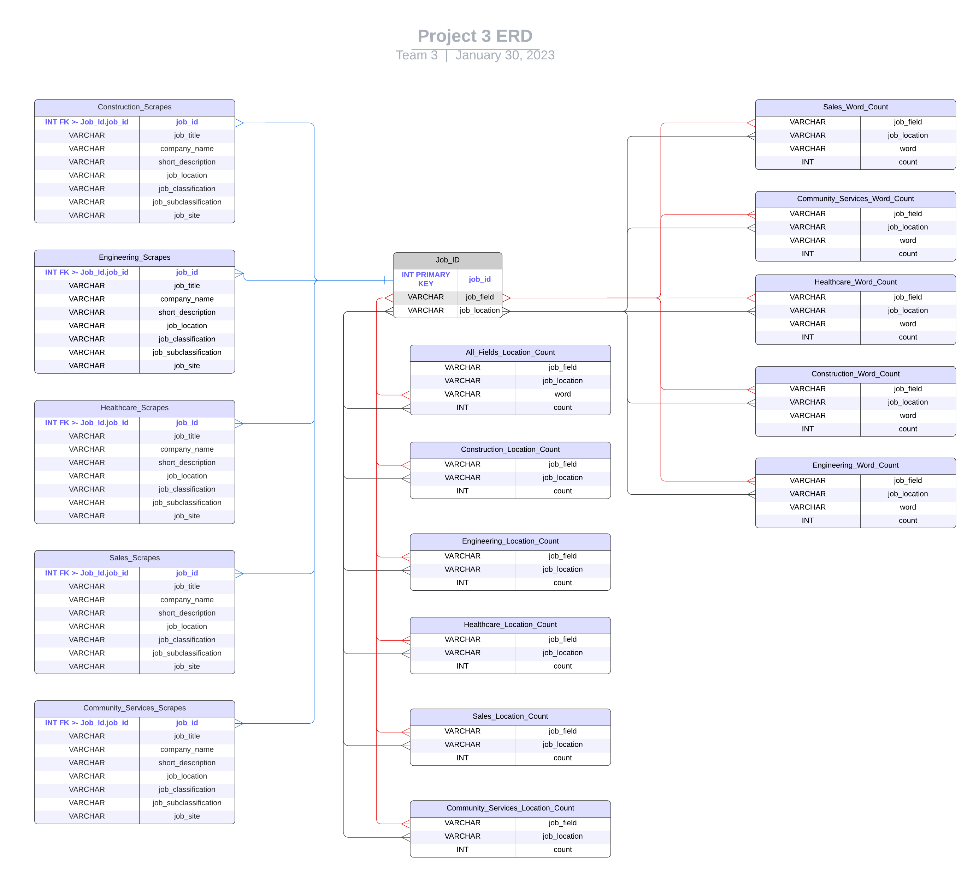
Database Diagram
Tables created with data for plotting, and for any future queries as required.
Tables are linked via JOB ID table.

Slide 7
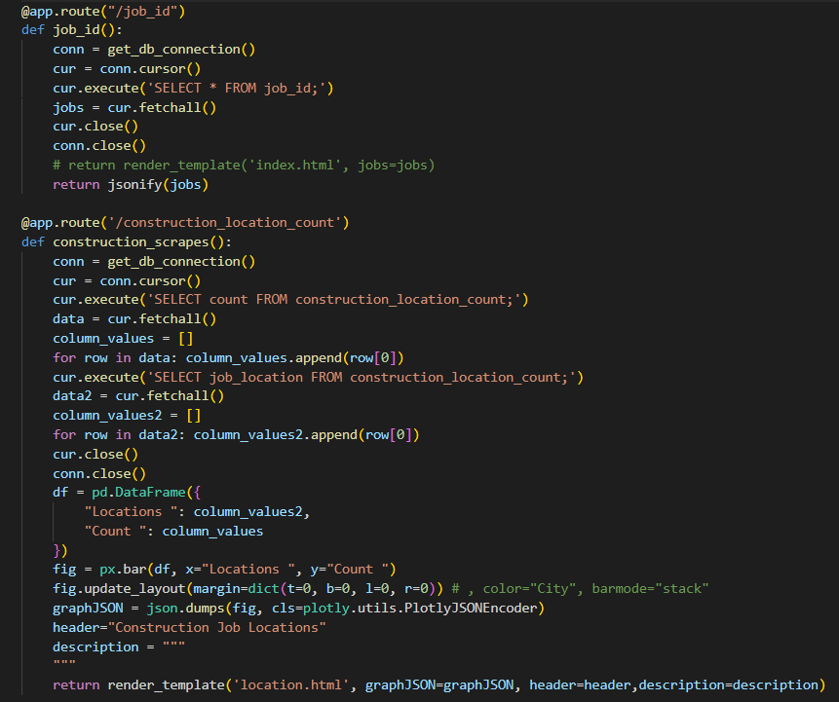
Flask App
FLASK APP

Slide 8
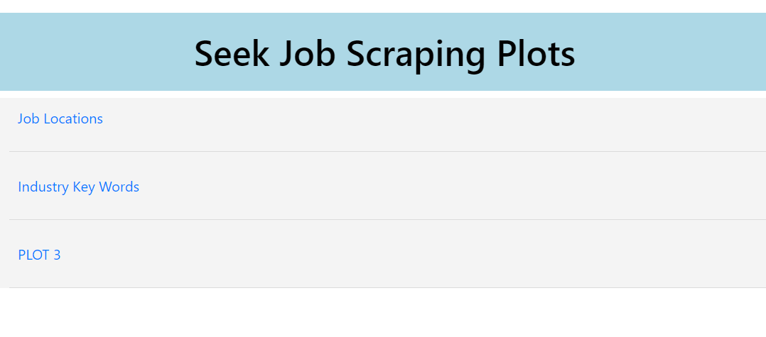
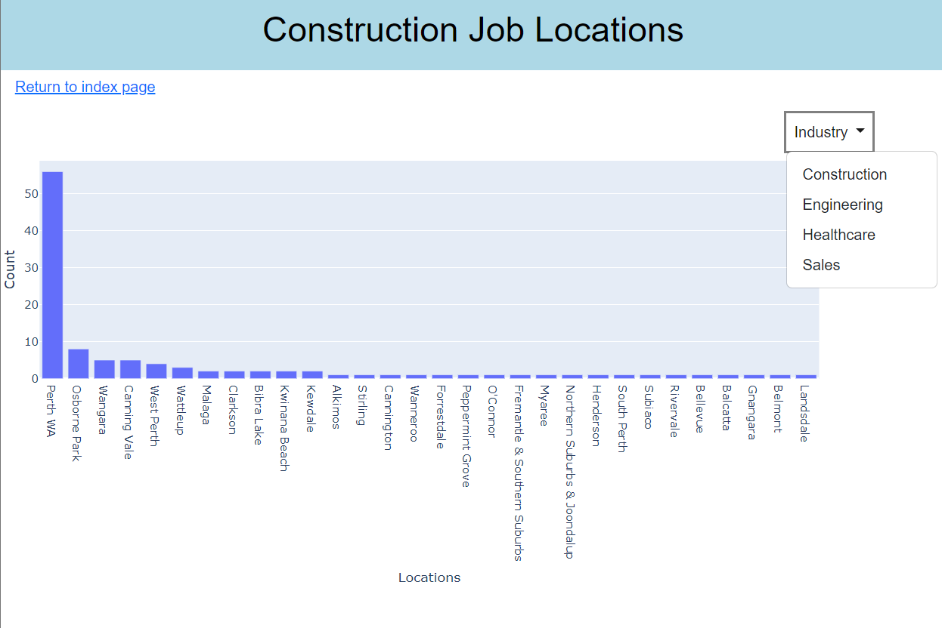
Front-end Visuals
PLOTS / VISUALS / FRONT END
A homepage was created with interactive links to take the user to either the Job Locations or Industry Key Words graphs.
Job Locations bar graphs were used to represent the location listed in the job advertisements and the frequency in which these locations occur.

Slide 9
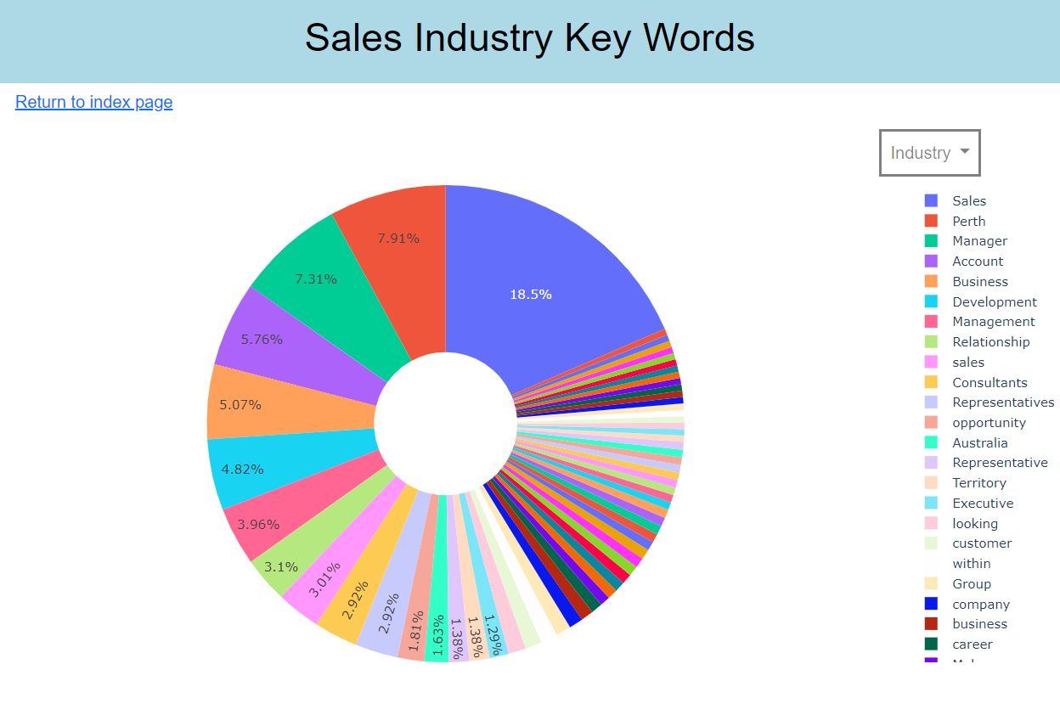
Front-end Visuals
PLOTS / VISUALS / FRONT END
Pie charts depicting Industry Key Words were used to visualise the frequency of words listed in job ads.

Slide 10

FUTURE DEVELOPMENT
ADD ALL JOB SITES FOR EXPANDED SEARCH
REFINE AND IMPROVE USER INTERFACE
INTRODUCE A FUNCTIONAL INTERACTIVE
SCRAPE FOR VARYING LOCATIONS

Slide 11

TEAM MEMBERS – EMILY COXON, JONATHON WOOD, SANDRA REYES

